Slide 1
Common Urological ailments- symptoms ,treatment & prevention.
Dr. V.K.Mishra
Consultant Urologist & Director
Kanpur Urology Centre
Kanpur

Slide 2
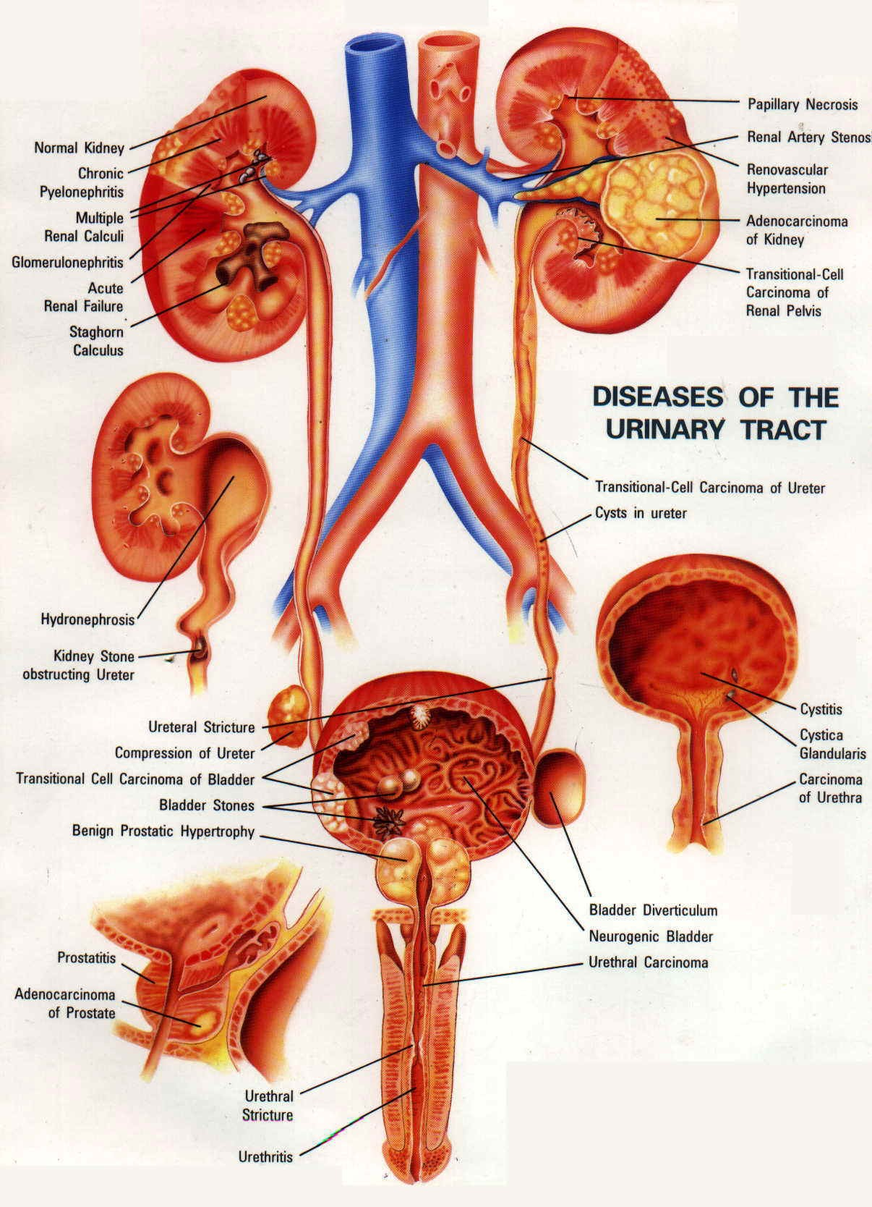

Slide 3
Introduction
The Urological problems are manifested in all age groups ranging from a newborn baby up to geriatric group. With the advances in technology, it is possible now to detect many diseases even at the level of embryo.

Slide 4
Pediatric Problems
New Born Baby
They usually present with congenital disorders like.:
Absence of testis or at abnormal location.
Retractile Testis
Phimosis
Abnormal opening of Urinary meatus.

Slide 5
What is the ideal age for consulting a expert ?
For Testis before 12-18 months.
For Phimosis at an earliest
(non opening of skin over penis)
For Abnormal opening immediately after birth
of Urinary meatus

Slide 6
Children
Urinary Infection
Bed wetting
All children with documented urine infection must be shown to a urologist & proper investigations must be done.
For children with bed wetting even after 2-3 yrs of age ,proper counseling is required to avoid psycho-social & medical complications.

Slide 7
Bed wetting
The general guidelines are:-
Proper Intake of fluids
Timed urination
Restricting fluids in the evening & night
Alarm voiding at night
Medicines as advised by Urologist

Slide 8
Young adults
The common causes are:-
Urinary & genital infections in case of inadvertent extramarital sex, one must contact an expert
Stones
Obstruction in urinary passage due to stricture etc;

Slide 9
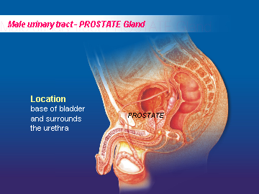
Elderly population
Males
The commonest
problems is the
enlargement of prostate
which is a ageing
process.

Slide 10
Prostatic enlargement (BPH)
The common symptoms are :-
Poor urine flow
Thinning of stream
Urgency
Innvoluntary loss of urine
↑ urine frequency leading to disturbance in work
or night sleep
Occasional blood in urine

Slide 11
Prostatic enlargement (BPH)
Prostate enlargement is a ageing process
& may not be disease at all.
Only symptomatic person need treatment
which may be medical or surgical depending upon the duration & severity of problem.
The size of prostate has no relation with symptoms & even small prostate may need treatment.

Slide 12
Prostatic enlargement (BPH)
Treatment
MEDICAL
SURGICAL
TUR(P)
The gold standard
method for removal of
enlarged prostate
Recommended for
mild to moderate
Symptoms of
enlarged prostate

Slide 13
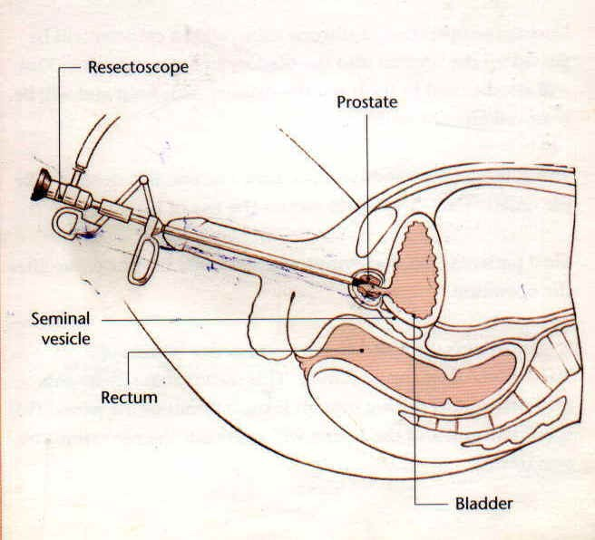

Slide 14
How can I prevent prostatic enlargement ?
Till date no conclusive drug/diet is identified
which can prevent prostate enlargement as it
is a ageing process. However few tips may be
useful.:-

Slide 15
Tips to prevent urine retention
Avoid excess intake of fluids
Avoid constipation
Do not delay urination
Avoid taking liquids, liquors in late evening & night
Do not practice self medication as medicines like cough syrups, some drugs for blood pressure & neurological illness are known to cause obstructive urinary problems.

Slide 16
Do I have prostate cancer ?
It needs a checkup & physical examination & some investigation to rule out prostatic
cancer.
A screening of all males over the age of 50
years is recommended by American
Urological Association.

Slide 17
How frequently this checkup is required ?
Ideally at yearly interval but practically on the
advise of concerned urologist

Slide 18
Can we prevent cancer of the prostate ?
Not exactly but we Indians are lucky as
compare to Americans as the incidence of
cancer of prostate is quite low probably
because of racial, genetic or dietary factors
It has been seen that diet rich in fat & protein
predispose to prostate cancer, whereas high
carbohydrates, rich minerals & vitamins especially C
& E are protective

Slide 19
Other cancers of Genitourinary system
Urinary Bladder
Kidney
Testis
Penis
The commonest symptoms is:
Blood in urine

Slide 20
Is Cancer of Bladder Curable ?
Yes, in early stages , it can be treated by endoscopy alone.

Slide 21
Is cancer of bladder preventable ?
Yes !
The current known risk factors are :-
Smoking
Exposure to chemicals & Dyes etc;
Vitamin C is said to have protective role

Slide 22
Other causes of blood in Urine
Infection
Stone
Injury

Slide 23
How are stones formed & what are the treatment options ?
The stones are formed either in kidney or urinary bladder & there are numerous causes responsible for it. The treatment options depend upon number of factors.

Slide 24
Treatment of Urinary stones
Small Stones
Hydration (excess fluids)
Medicines
Medium Size Stones
Kidney :- Lithotripsy
Ureter :- PCNL(Key-hole surgery)
URS (endoscopy through urethra)
Bladder:- CLT (removal of stone through urethra)
Large Stones :- Lithotripsy ± PCNL

Slide 25
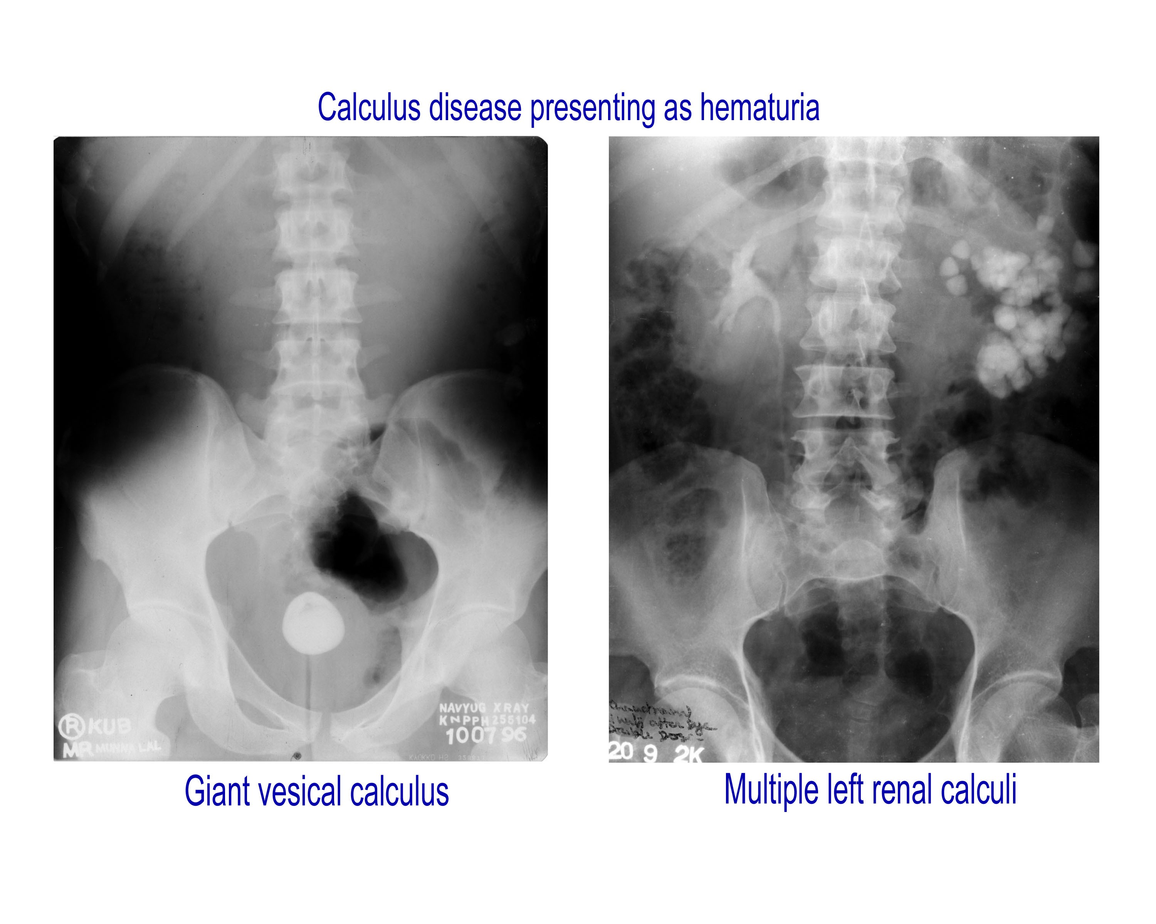

Slide 26
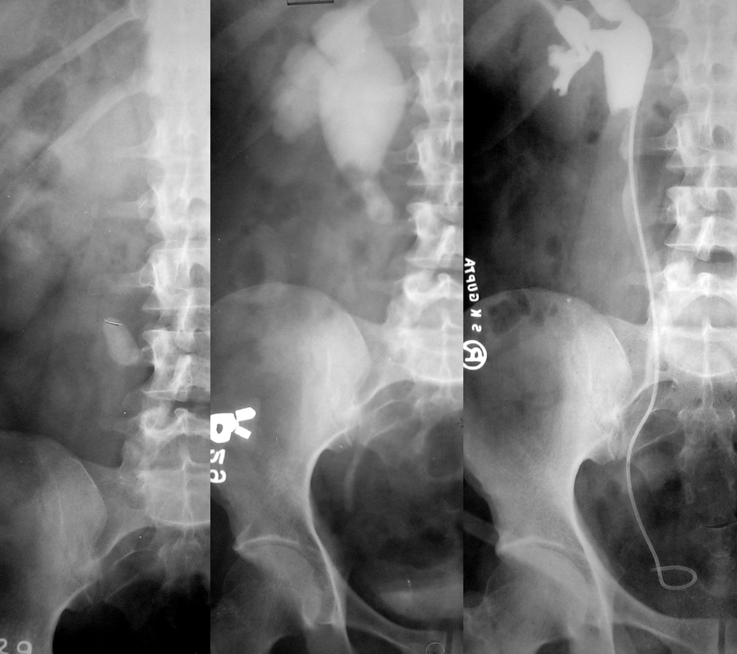
Therapeutic Options
Upper Ureteric calculus
Small Large
(<15X10 mm)
Dur. Small long
Imp. Min mod.
Dil. Min. mod
Fav. Unfav.
ESWL retro
in situ manu. PCUL Lap/ Open
ESWL Failure

Slide 27
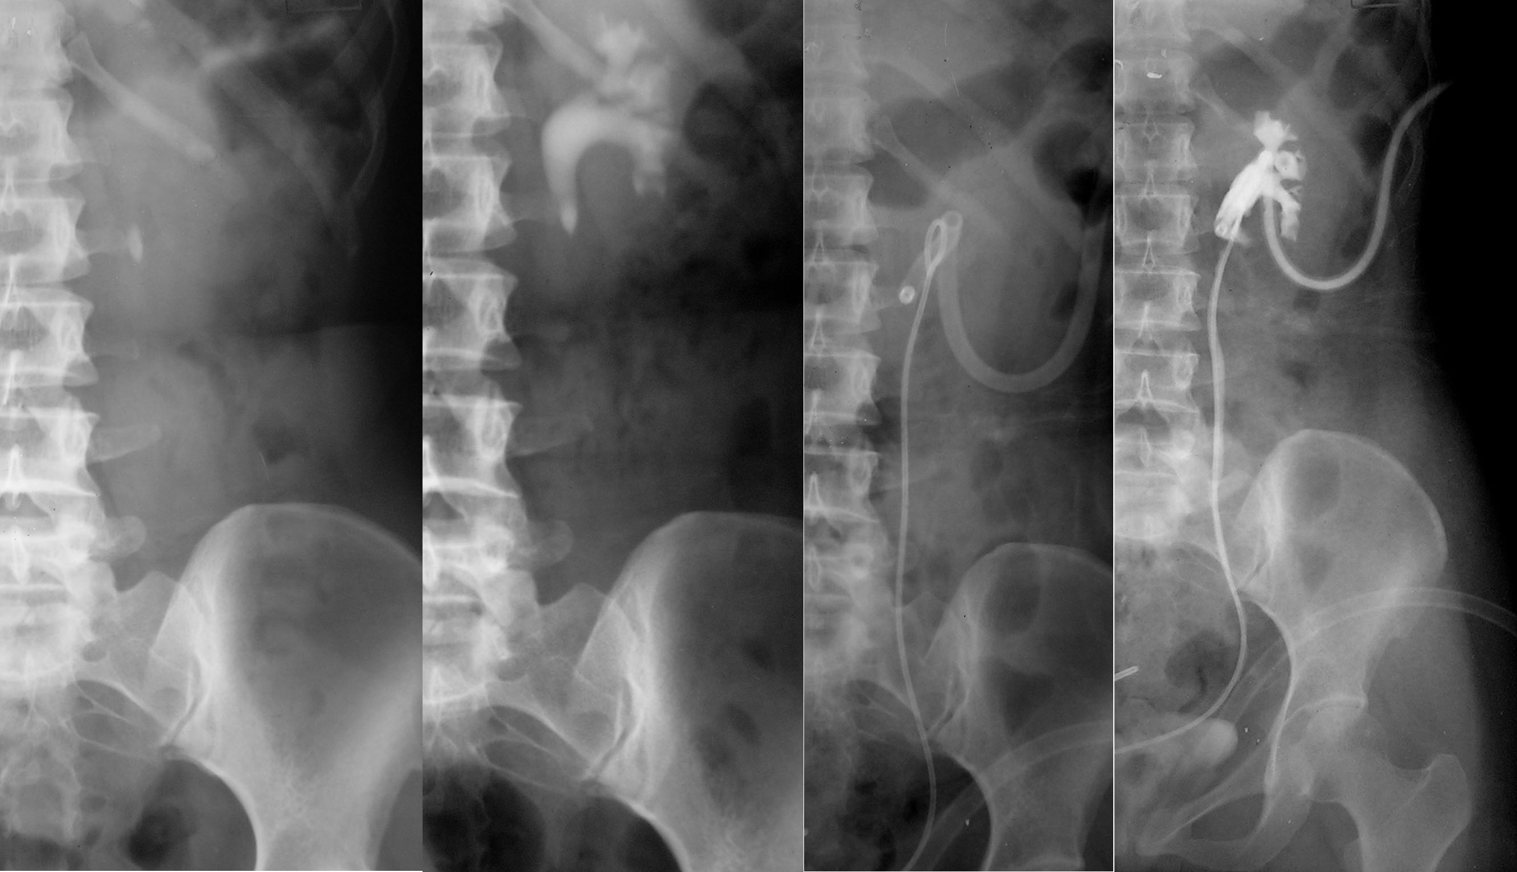
Thank You

Slide 28
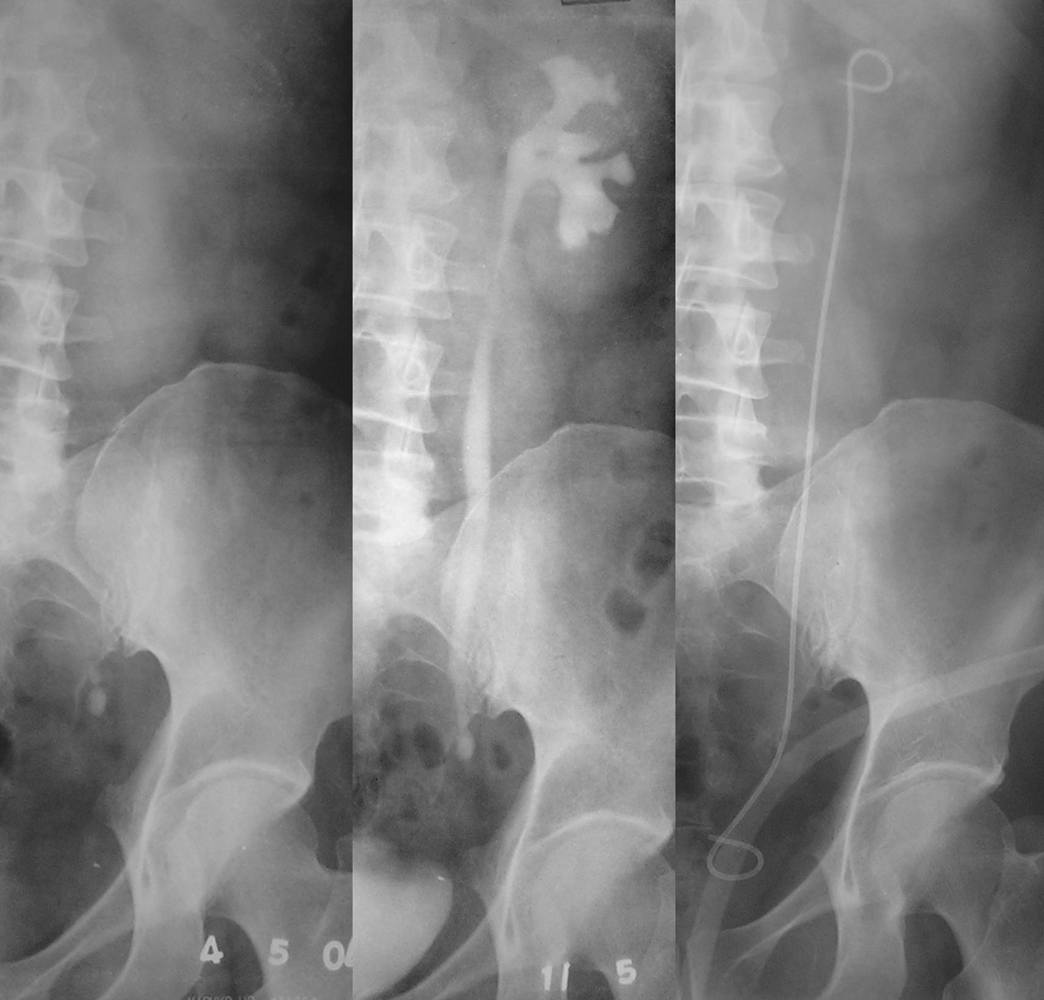
Therapeutic options
Lower Ureteric stone
URS (<5 mm
Energy Source Up migration hard & Expectant
not approachable therapy
-US Tt acc. To
-EHL site
Pneumatic Staged/ ESWL Basketing
Lasers Bypass
Failure
Open Surgery

Slide 29
What are the risk factors for stone disease ?
Obesity
High fat diet
Low water intake
Hot & humid climate.
Water rich in calcium & phosphate.

Slide 30
What are the causes of kidney failure & how can we prevent it ?
Reversible causes
1. Stones
2. Infection
3. Obstruction
in urinary passage
Controllable causes
Diabetes
Hypertension
Analgesic & Drug abuse

Slide 31
How to prevent kidney failure?
Seek prompt advice of expert.
Identify reversible factors & get remedial treatment.
Abide with the advice of expert.
Seek proper treatment & have regular follow ups as per directives of expert.

Slide 32
What are common urinary problems of females & its prevention ?
The urinary problems of females are seen in
all age groups but mainly at the time of
menarche ,pregnancy & menopause because
of hormonal changes.
The mainstay of treatment is personal
hygiene, proper medication & hormonal
support if required.

Slide 33
Urinary problems in females
Another problem is that of involuntary leak of
urine during laughing (gigle incontinence),
coughing, sneezing or squatting which is fully
correctable either by medicines or surgery.

Slide 34
Take home message
Urinary problems can occur at any age group.
A prompt diagnosis, thorough investigation & treatment of the disease is warranted to avoid complications.
Even a common problem of urine infection should also not be overlooked.

Slide 35
Take home message
The common symptoms are burning in urine, increased frequency, thin stream, poor flow, urine leak, blood in urine flank pain, swelling over face or limbs etc; may indicate the affection of Urinary system for which an expert must be consulted at an earliest.

Slide 36
Take home message
The recent advances has practically obviated the need for open surgery & nearly all diseases are being treated either by machine (lithotripsy for stones), key hole surgery (PCNL) or even by endoscopy.
An early institution of therapy may prevent even kidney failure.
With the better understanding of diseases like stone, prostate & cancers dietary & other preventable measures can also be undertaken.

Slide 37
Thank You

