Slide 1
Management of Urolithiasis- The present scenario
Dr. V.K.Mishra
Director & Consultant Urologist
Kanpur Urology Centre
Kanpur

Slide 2
The Problem
The prevalence of stone disease is 2-3%.
The recurrence rate without treatment for CaO stone is >10%-1yr., 35%-5 yrs & 50% at 10 yrs.
If untreated it results in hematuria, recurrent UTI, pain, work loss, renal dysfunction & eventually in renal failure.
Factors like genetic, familial , hereditary , climatic, sedentary habitat, hard water & lithogenic diet contribute to stone disease predisposition.

Slide 3
Urolithiasis
Symptomatic
- Flank Pain
- Hematuria
- Graveluria
- Recurrent UTI
- Renal insufficiency
- Anuria
Asymptomatic
Routine medical checkup
USG /CT scan for other medical ailments

Slide 4
Screening Tests
Routine urine exam
Plain X ray KUB AP view
S. Creatinine, S. Uric acid (fasting)
USG of KUB region (+/- depending upon the clinical situation)
Definitive tests
IVU
CT Urogram
RGP/Nephrostogram

Slide 5
Radiological evaluation
Stone
(on Xray)
Uroradiographic
(IVU/RGP/Nephro/ CT Urogram)
Others
(extraurinary)
Renal functions
Renal anomalies
Caliceal anatomy
UPJ anatomy
Ureteral course & caliber
Status of contralateral kidney
Distal tract
Spine, ribs &
pelvic anatomy
Vascular calcification
Mass lesions
Total burden
(no. & size)
Location
Composition

Slide 6
Stone factors
Total burden
Number* Size*
Solitary- ESWL <2 cms.- ESWL
2-3 - ESWL
>3 ESWL/PCNL 2-4 cmsESWL+DJ
Giant staghorn-
Open/ PCNL±ESWL >4cms-PCNL±ESWL -Lap/Open
* If other factors are favorable

Slide 7
Stone factors (contd.)
Composition
Opacity
Cal.phosphate
Cal.phosphate+Oxalate
Cal. Oxalate
Struvite
Cystine
Uric acid
# in decreasing order
Appearance
CaPo4-smooth & dense
Caox- stippled irregular
Struvite-variable laminated-infected
Brown gravel-uric acid

Slide 8
Radiological Evaluation
Spine
Ribs
Pelvis
Bony abnormality Pigeon chest Prosthesis
Selection of Relation with Arthrodesis
Modality kidney
Positioning

Slide 9
Whether the patient is having urolithiasis
Is any therapy indicated?
If yes, which modality?
- Conservative
- Endourological
- ESWL
- Surgical
- Multimodality

Slide 10
Expectant therapy
For ureteral stones, the width & shape is most important.
<4 mm 80%
4-6 mm 59%
>6 mm 21%
How long to wait ?
2-6 weeks
For which stones ?
Moving small, round & smooth stones

Slide 11
Therapeutic options
Renal pelvic stone
Pelvic only
Pelvicaliceal
Staghorn
2 cms 2-4 cms 4 cms
Solitary. Pelvicaliceal
Dilated Undilated
ESWL/ PCNL PCNL/
PCNL +/-ESWL Open
PCNL/OPEN PCNL/OPEN
ESWL of residual stones
ANATROPHIC NEPHROLITHOTOMY IS THE PROCEDURE OF CHOICE FOR COMPLEX STAGS
PCNL ESWL + DJ
CHEMODILUTION OF RESIDUE

Slide 12
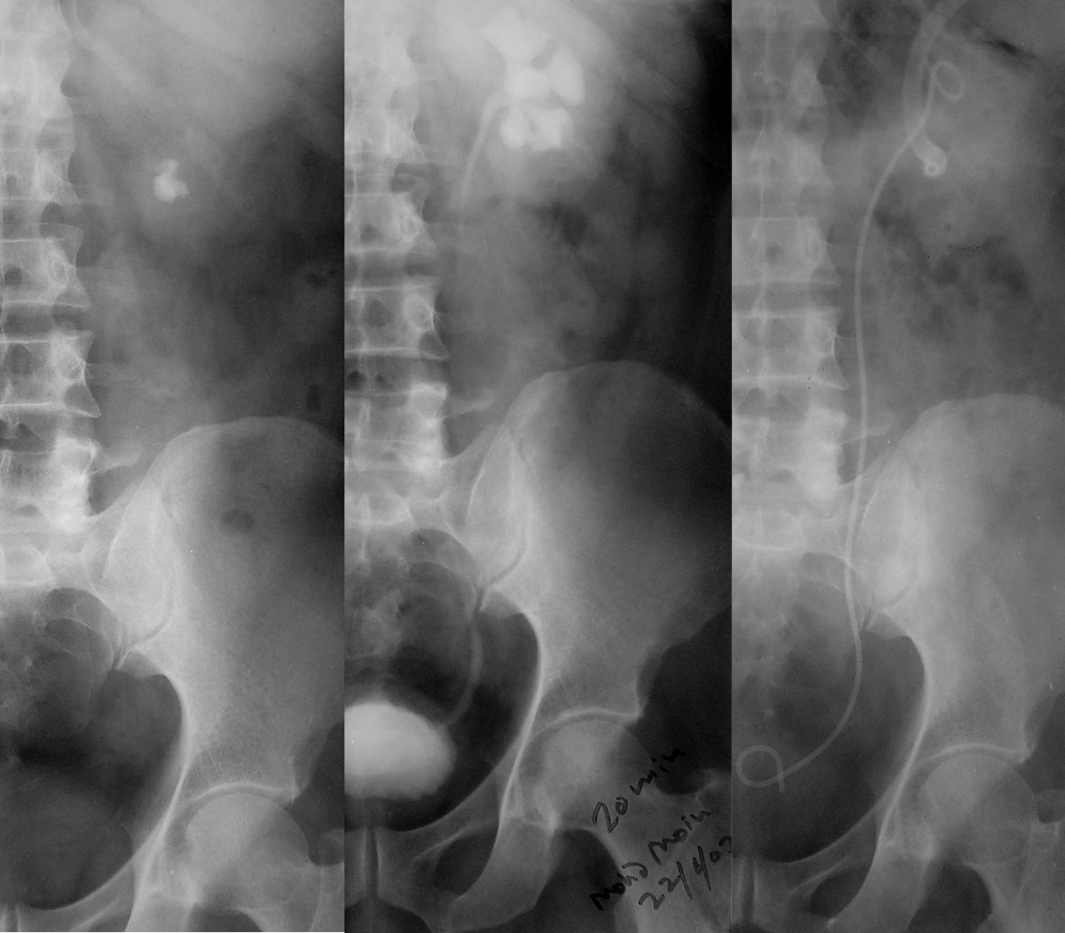
Solitary. Pelvicaliceal
Dilated Undilated
PCN/OPEN PCNL/OPEN
ESWL of residual stones
ANATROPHIC NEPHROLITHOTOMY IS THE PROCEDURE OF CHOICE FOR COMPLEX STAGS
PCNL ESWL + DJ
CHEMODILUTION OF RESIDUE

Slide 13
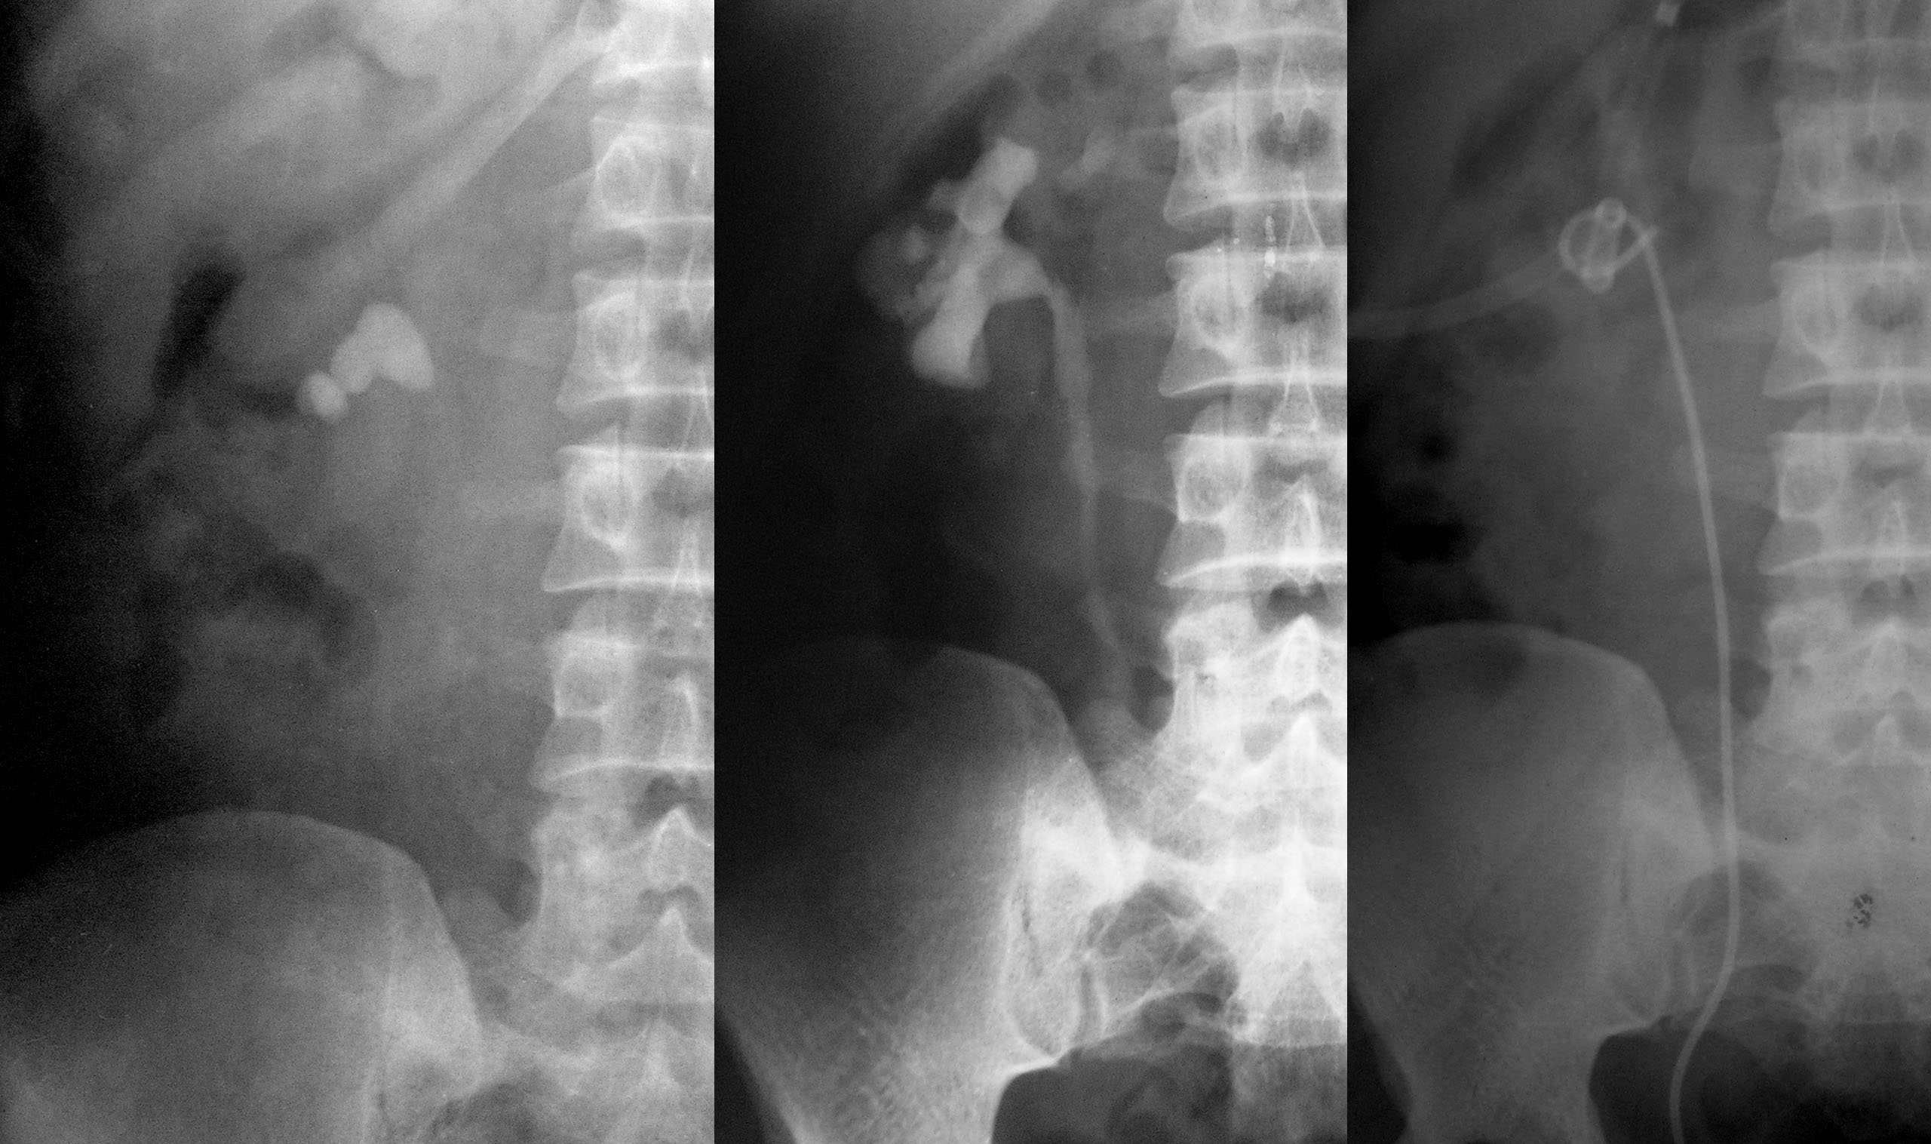

Slide 14
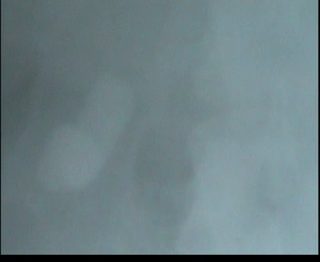

Slide 15
Therapeutic Options
Upper Ureteric calculus
Small Large
(<15X10 mm)
Dur. Small long
Imp. Min mod.
Dil. Min. mod
Fav. Unfav.
ESWL retro
in situ manu. PCUL Lap/ Open
ESWL Failure

Slide 16
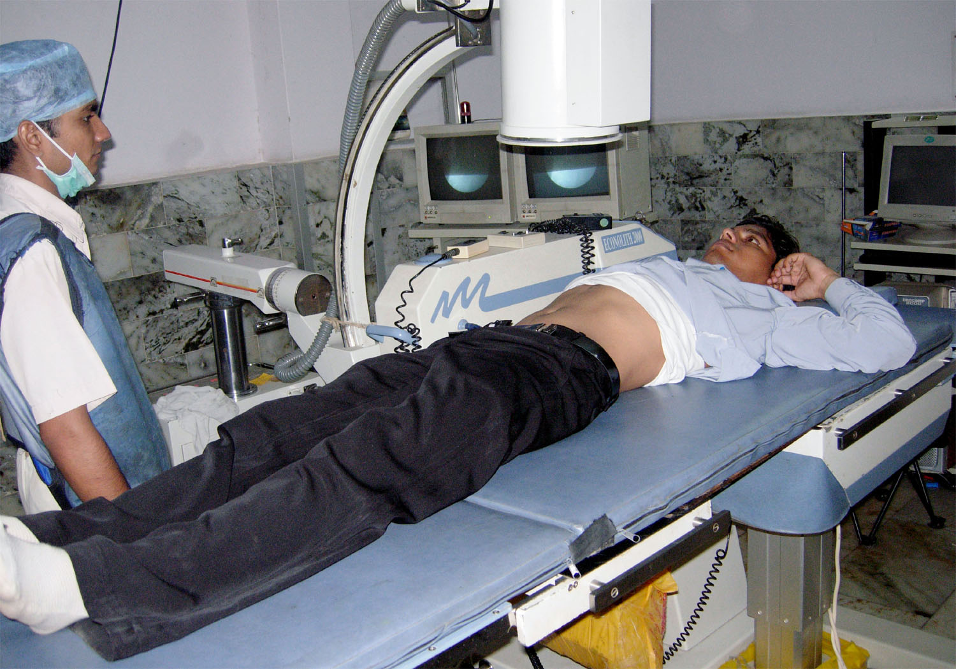

Slide 17
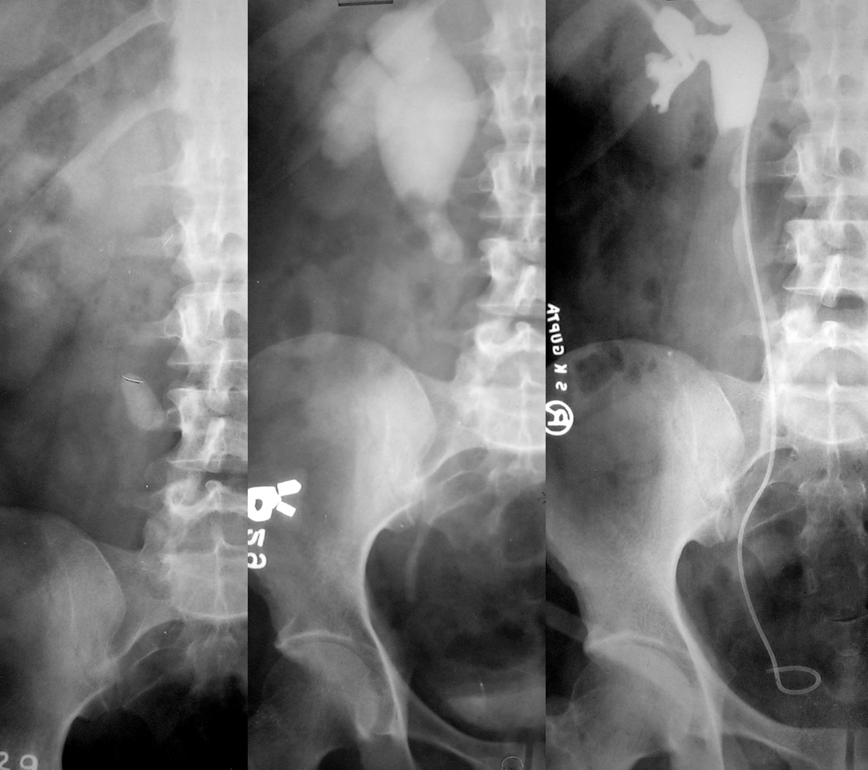
Therapeutic Options
Upper Ureteric calculus
Small Large
(<15X10 mm)
Dur. Small long
Imp. Min mod.
Dil. Min. mod
Fav. Unfav.
ESWL retro
in situ manu. PCUL Lap/ Open
ESWL Failure

Slide 18
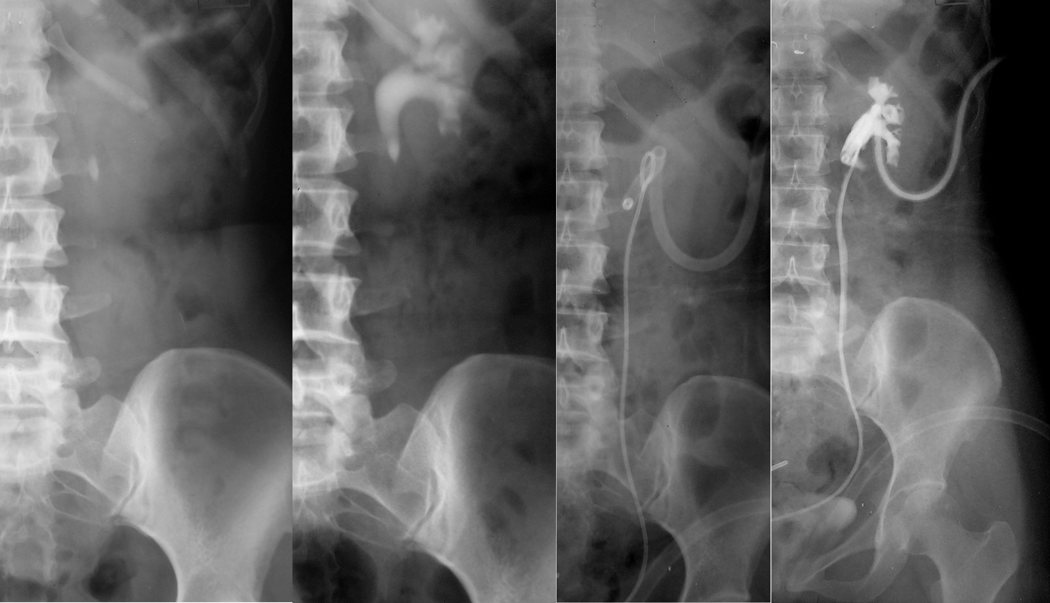
Thank You

Slide 19
Therapeutic options
Lower Ureteric stone
URS (<5 mm)
Energy Source Up migration hard & Expectant
not approachable therapy
-US Tt acc.to
-EHL site
Pneumatic Staged/ ESWL Basketing
Lasers Bypass
Failure
Open Surgery

Slide 20
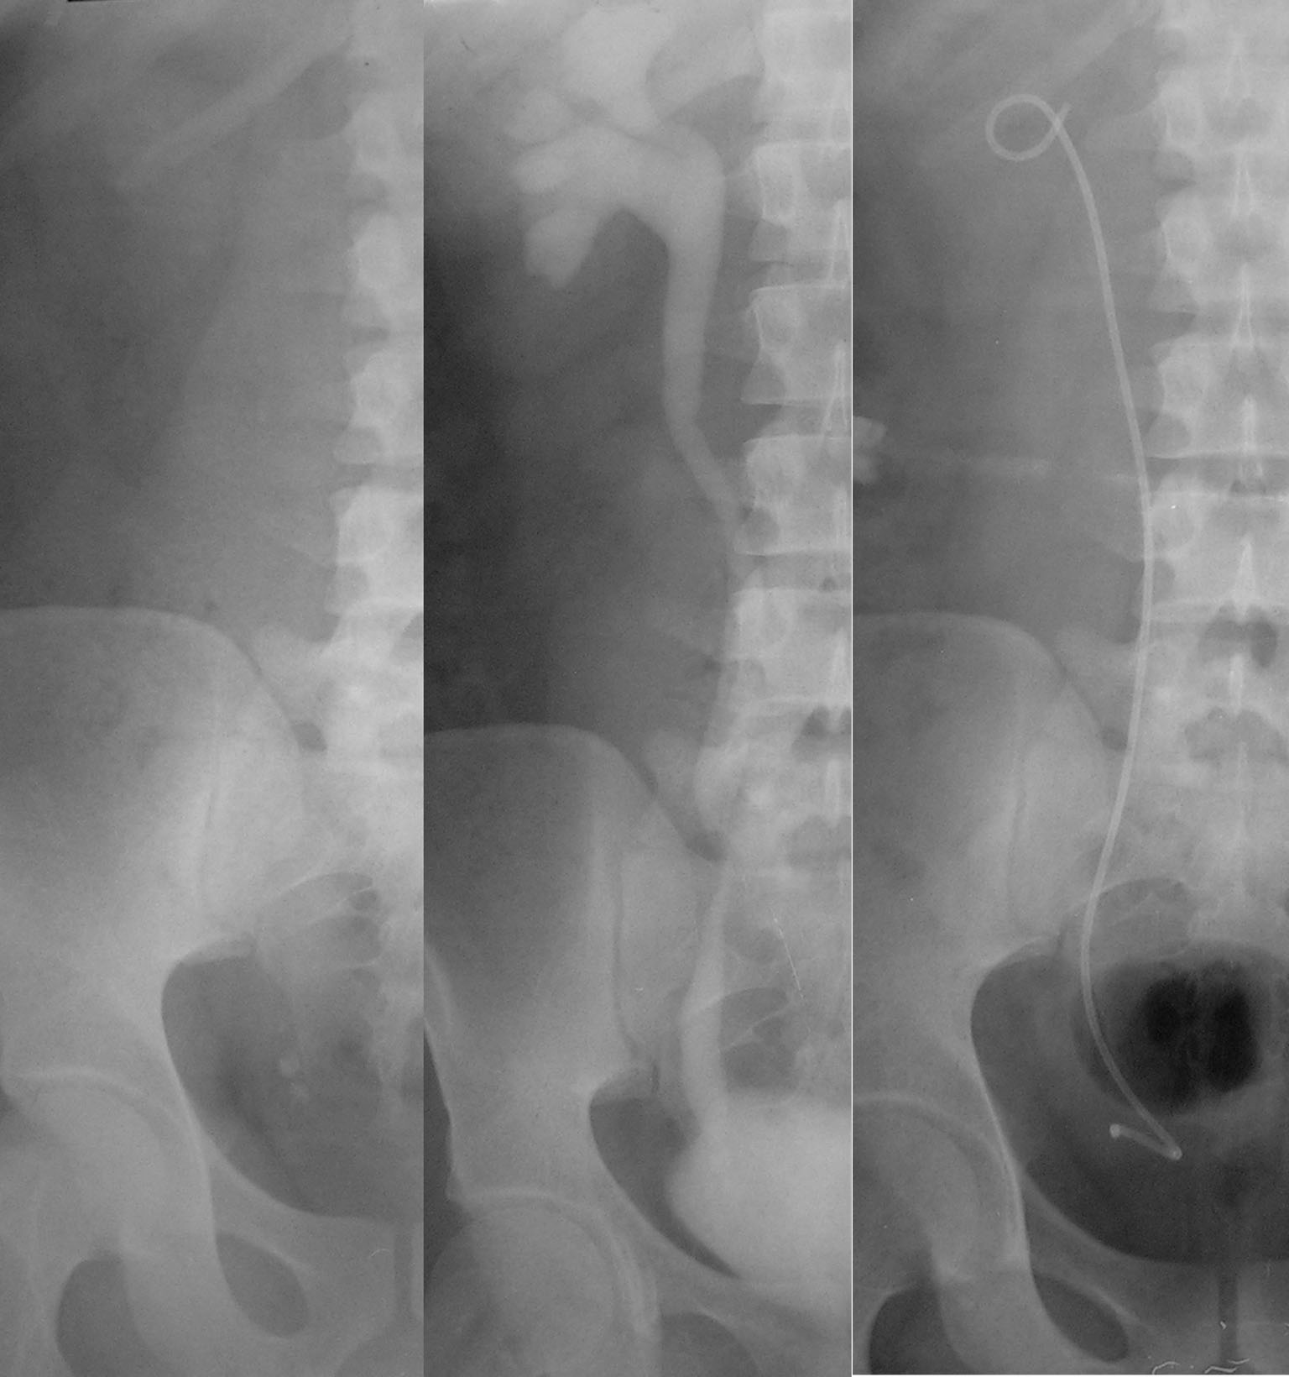
Thank You

Slide 21
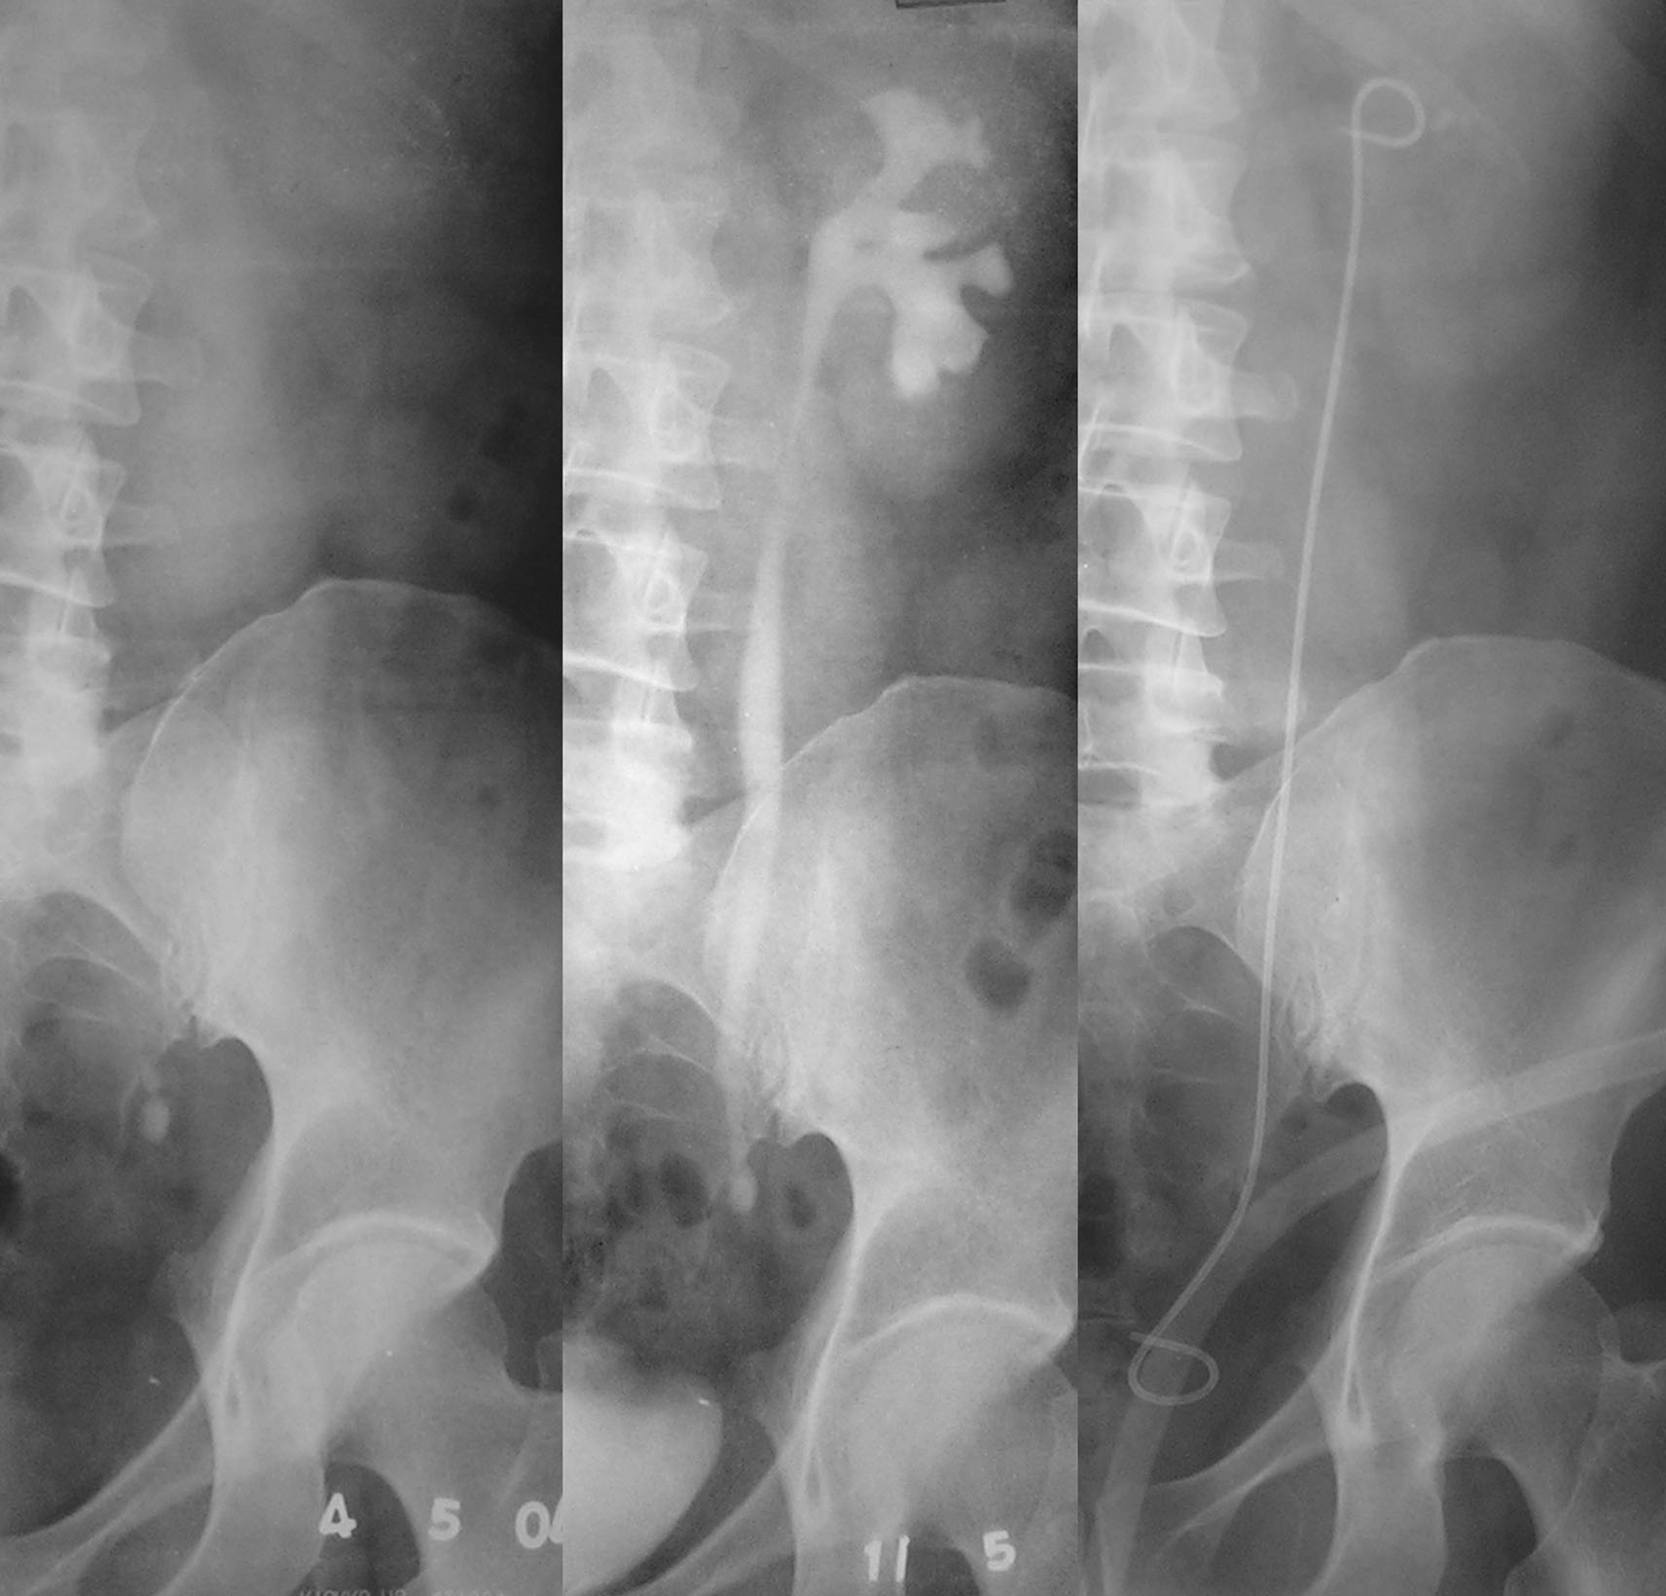
Therapeutic options
Lower Ureteric stone
URS (<5 mm
Energy Source Up migration hard & Expectant
not approachable therapy
-US Tt acc. To
-EHL site
Pneumatic Staged/ ESWL Basketing
Lasers Bypass
Failure
Open Surgery

Slide 22
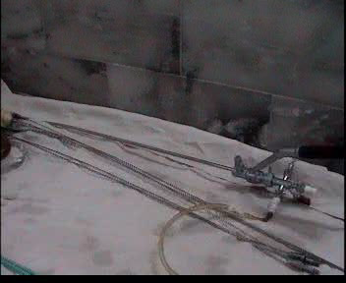

Slide 23
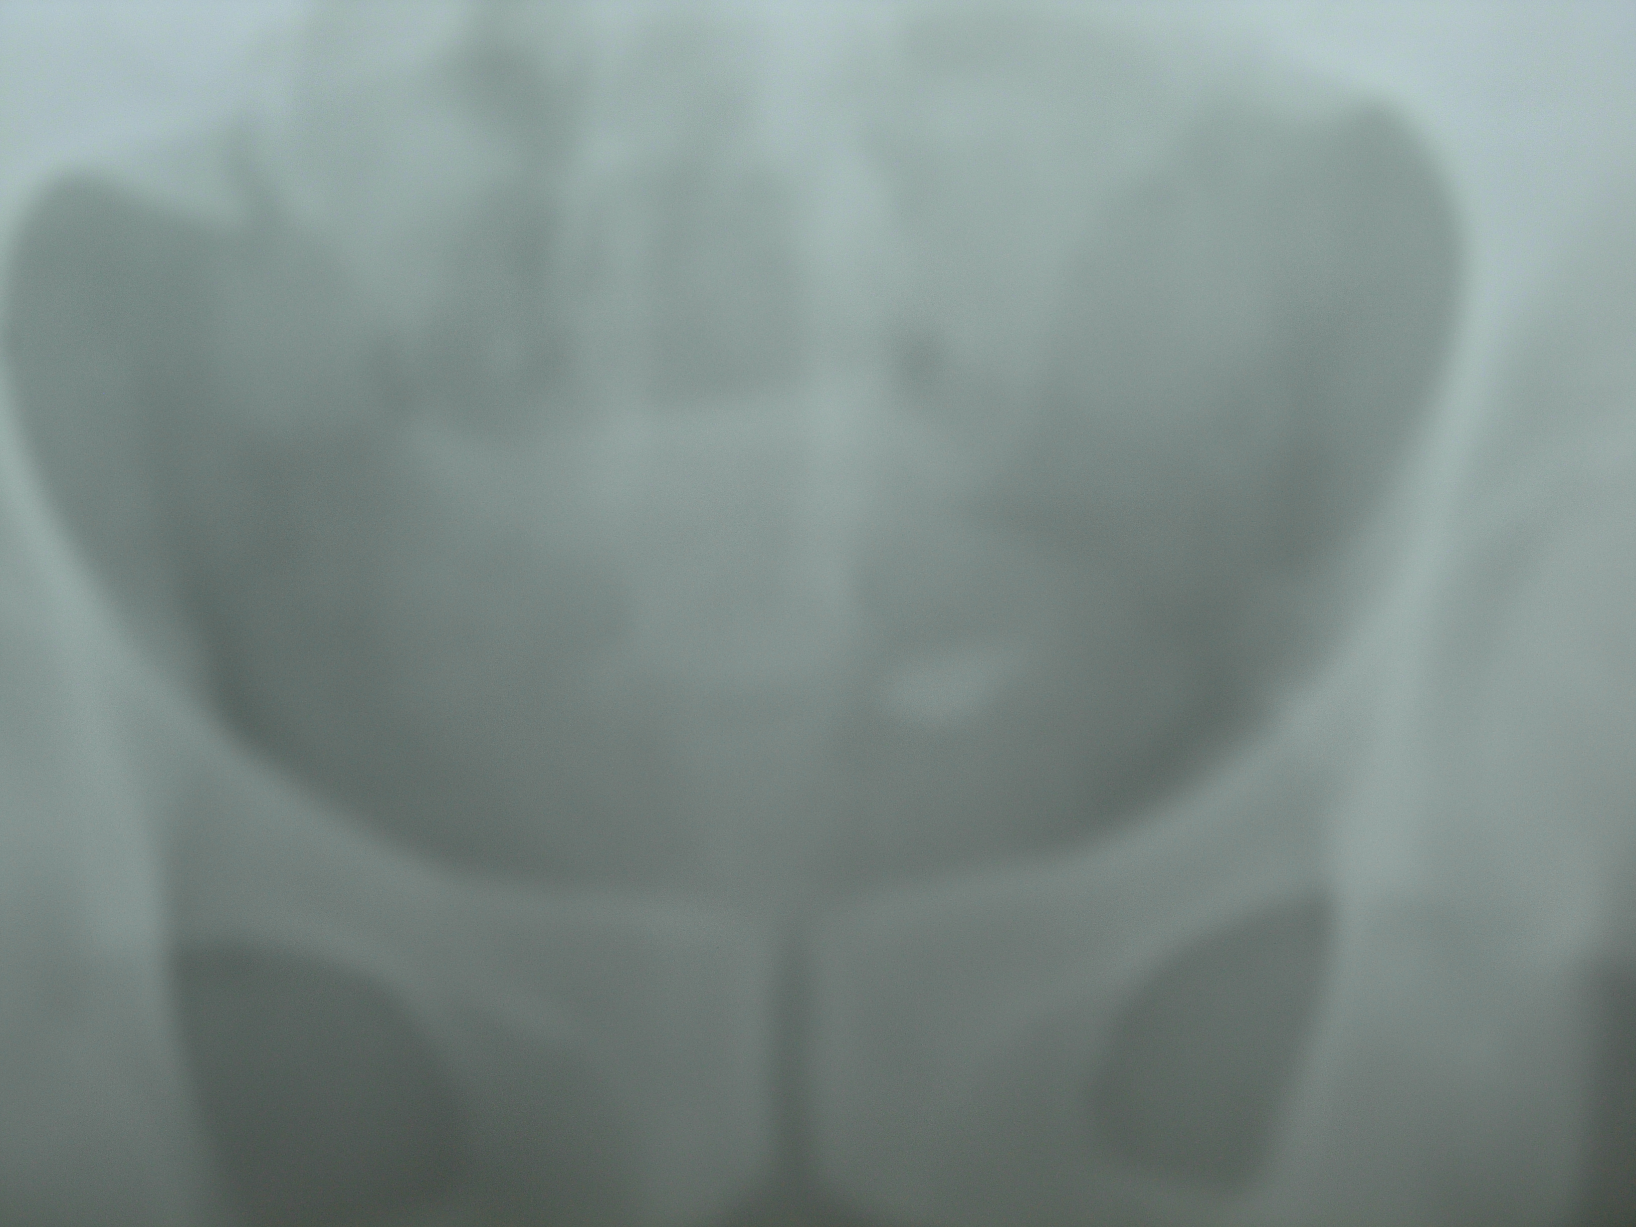
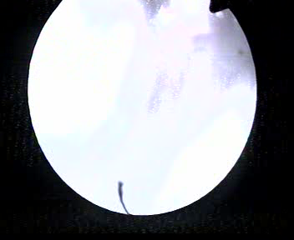
VESICAL CALCULUS

Slide 24
Lap/Open surgery
(Elective for ureteric)
Stone System Patient
Very large Unfavorable Economic
Impacted
Failure of Distal stricture unwilling
non-operative Following total hip
modalities diversion replacement
Laparoscopic surgery has practically replaced all above indications but is limited by lack of widespread use

Slide 25
Lap/Open surgery
(Elective)
Stone System Patient
Complicated stags Unfavorable Economic in solitary unit
Calcium Oxalate Secondary stones Unwilling
mono hydrate
Cystein stones Anatomical factors Morbid (relative) obesity
horseshoe lack of expe- malrotated rtise/resources
pelvic kidney

Slide 26
Open Surgery non elective
Complications of procedure
- Perforation
- Avulsion
- Vascular injury
- Urinary fistulae

Slide 27
Which patients need immediate hospitalisation
1. Patients with calculus anuria.
2. Symptomatic patients uncontrollable by
oral medication.
3. Patients with solitary kidneys
4. Patients with obstructive stones ,
infected urine with febrile episodes

Slide 28
Conclusions
Expectant therapy should be directed for smaller ureteric calculi.
Endourology is the main stay of the treatment
Laparoscopic surgery is gradually replacing the role of open surgery which already has a very limited role.
Immense potential for exploring the causative factors to prevent recurrences.

Slide 29
Thank You

