Slide 1
Current concepts in the management of BPH
DR. V.K.MISHRA
Consultant Urologist
B.R. STONE CLINIC
KANPUR UROLOGY CENTRE

Slide 2
Pathologist
Urodynamicist
Synchronous elevated detrusor & low flow in the absence of other factor causing BOO
(Nitti 2000)
Microscopic diagnosis
Cellular proliferation
    Strand berg 2000
BPH
Radiologist
Urologist
Elevation of bladder base in IVU
Enlarged prostate on USG.
(Hars & Resnick 2000)
Patient
Bothersome symptoms & signs in ageing male with enlarged prostate with or without complications
(Shapiro & Legor,1995)
Quality of life

Slide 3
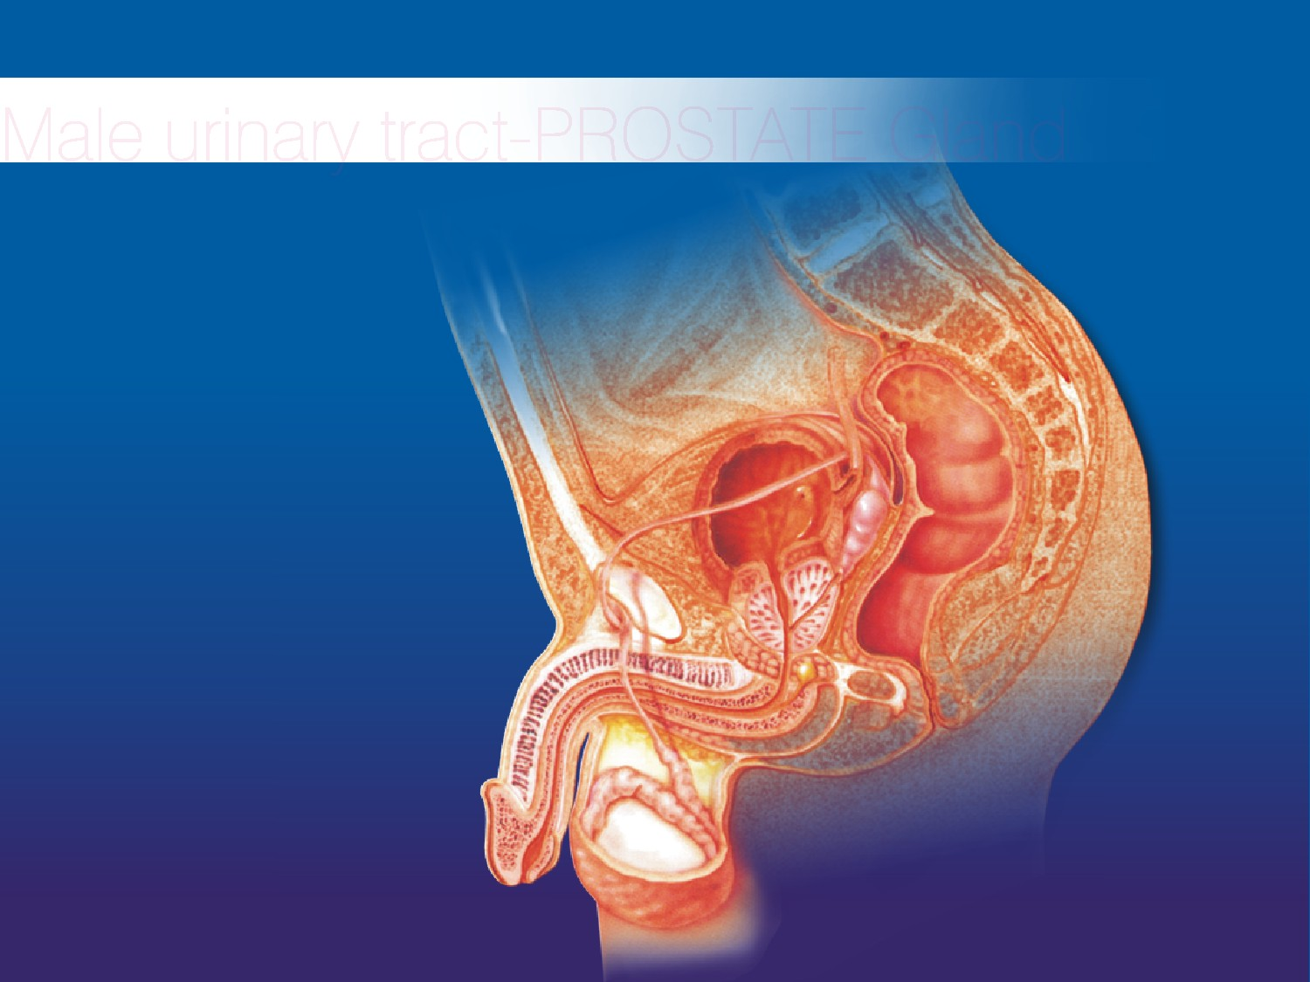
Male urinary tract - PROSTATE Gland
Location base of bladder and surrounds the urethra
PROSTATE

Slide 4
PROSTATE Gland
At birth- pea size
Gradually increase until puberty
Reaching normal adult size - walnut - third decade of life
At 55 yrs. Age, 25% men report decrease in urine flow.
At 75yrs. 50% men report decrease in stream.
20-30% men over age of 80yrs. may require prostatectomy.

Slide 6
Symptomatology
Symptoms of BPH
Obstructive symptoms
Irritative symptoms
Hesitancy
Impairment of size and force of urinary stream
Interruption of stream
Terminal dribbling
Retention of Urine
Nocturia
Daytime frequency urgency
Dysuria
Sensation of incomplete emptying of the bladder/ Sense of incomplete void
Urgency & Urge incontinence
Lower urinary tract symptoms (LUTS)

Slide 7
Symptomatology
Uncommon presentations
Severe uremia
Resistant anemia.
Hematuria.
Intractable UTI.
Careful history & examination to exclude: Stricture urethra (prior instrumentation), vesical calculus/ neurogenic bladder, prostatic abscess , meatal stenosis.

Slide 8

Symptom score cards
AUA Symptom score card
IPSS
DAN-PSS-1
Boyarsky score
Patient satisfaction

Slide 9
Medical history
Hematuria, UTI, urethral stricture
Diabetes
CNS disorder
Ret. of urine in the past
Instrumentation /Cath.
Exposure to drugs
Prior surgery
Voiding diary
anticoagulants
Alpha agonists

Slide 10
Physical Examination
Ext. genitilia (meatal stenosis)
Palpable urethral mass
Palpable bladder
DRE
Anal tone
Neurourological examination
Size of gland is no criteria to decide whether active treatment is required
(Rochborn el at 1987, Simonsen el al 1987)

Slide 11
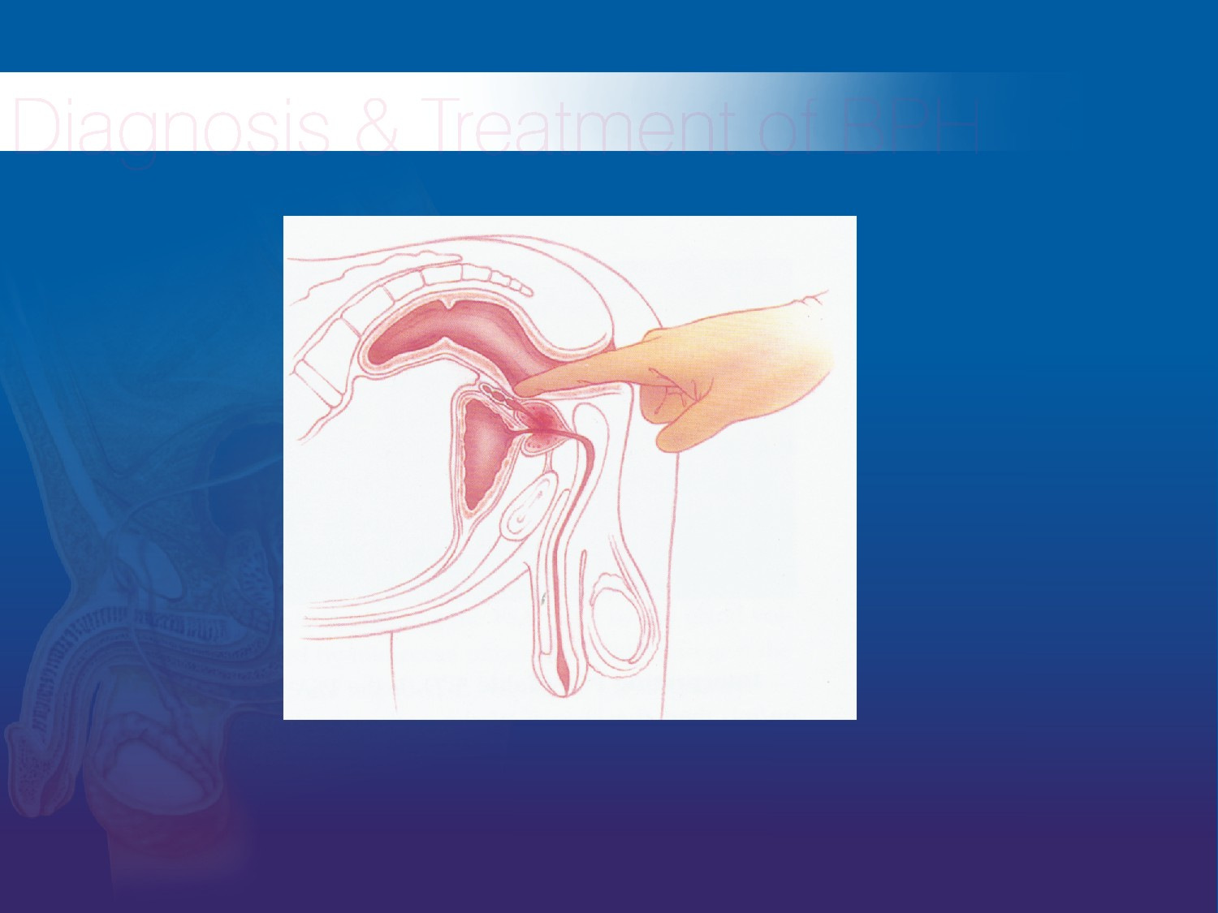
Diagnosis & Treatment of BPH
Digital rectal examination (DRE)
Physicians try to assess the size and texture of prostate to distinguish between prostate cancer and BPH:
Prostate cancer: Surface hard or woody
Tender: Prostatitis
Symmetrical enlargement & Smooth or elastic BPH

Slide 12
Investigations
Routine urine examination
Urine C&S
Serum chemistry ( Blood Urea, S.Creat., RBS, TLC, DLC, PSA including free PSA )
USG Of KUB region including comment on median lobe and post void residue
Trans rectal ultrasound (TRUS)- optional.
Uroflowmetry
Pressure flow study (CMG ) if indicated.

Slide 13
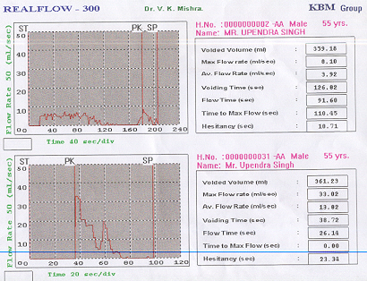

Slide 14
Benign Prostatic Hyperplasia
Dynamic Obstruction (40%)
Smooth muscle fibers of prostate and bladder neck are rich with alpha-1-receptors
The tone of these muscles play an important role in causing compression of prostatic urethra

Slide 15
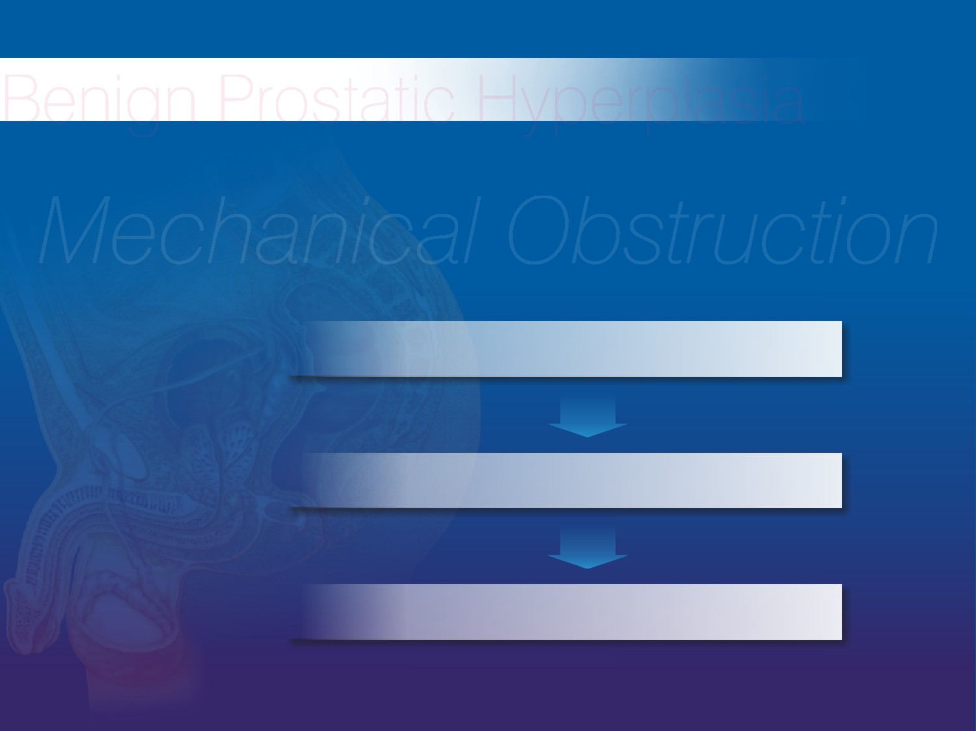
Benign Prostatic Hyperplasia
Mechanical Obstruction(60%)
Enlarging mass of tissue
Ability to increase outlet resistance
obstruct urine flow.

Slide 16
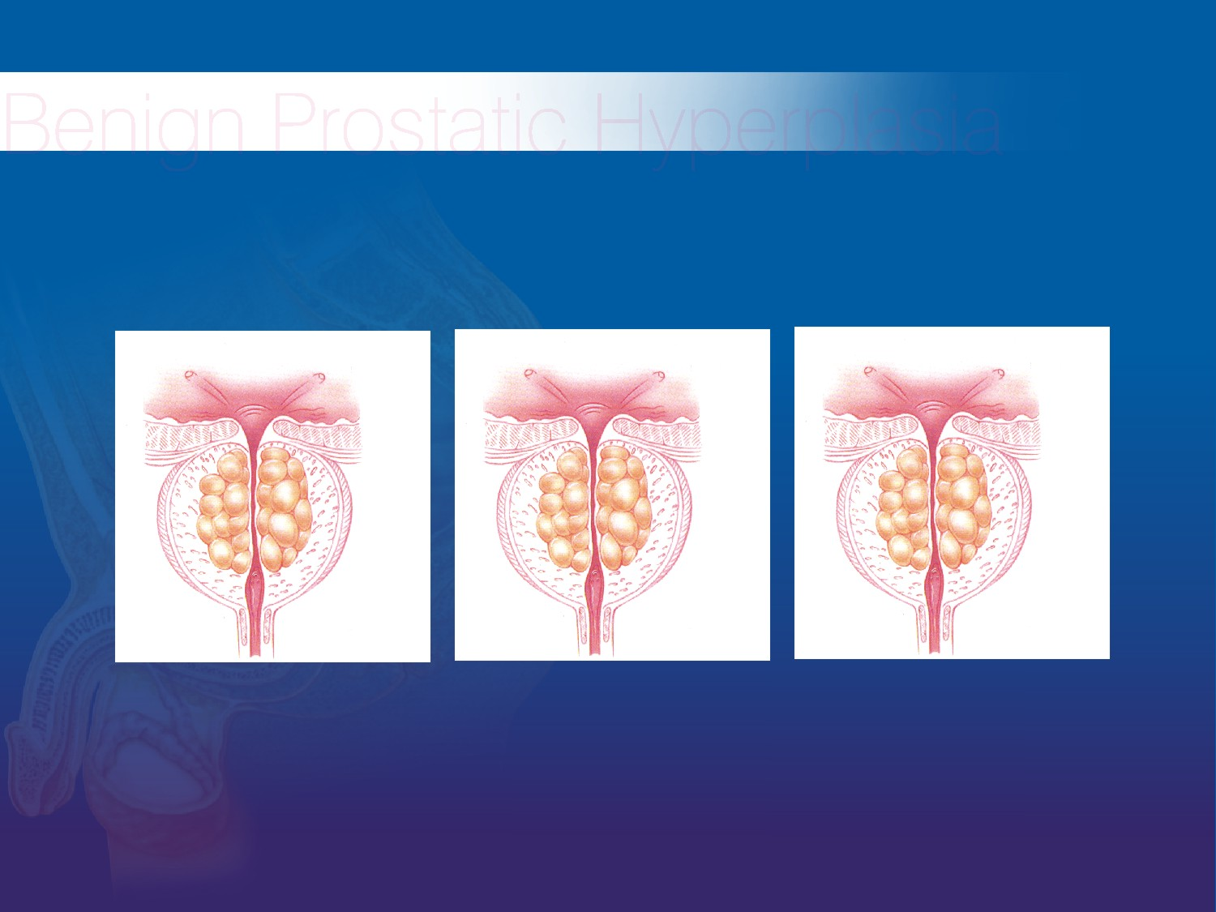
Benign Prostatic Hyperplasia
a. Mild BPH
b. Moderate BPH
C. Severe BPH

Slide 17
ETIOLOGY
There is ↑ accumulation of epithelial & stromal cells in the periurethal region of prostate which could also be due to impaired programmed cell death. It could be the embryonic reawakening of stroma cells inductive potential
(Cunha et at 1983)

Slide 18
BPH is a stem Cell disease
(Issaaac & Coffey 1995)
Dormant Stem Cell
Proliferation
DNA Synthesis
Rarely devided
Proliferation
Androgens
Estrogen
Growth Factor
Neurotransmitters
↑
Terminal differentiation
Mature
Programmed Cell death (apoptosis)
Issac & Coffey 1984

Slide 19
Goals of treatment in BPH
Relieve LUTS
Decrease BOO
Improve bladder emptying
Ameliorate detrusor instability
Reverse renal failure
Prevent further episode of hematuria , UTI & retention.

Slide 20
Management Of BPH
BPH
MEDICAL
1. Watchful
waiting
2. Hormonal
3. Neuropharmo
-cological
manipulation
SURGICAL
1.Conventional TURP
2. Bipolar TURP
3. Laser TURP
4. TUIP
5. Open Prostatectomy
OTHERS
1.PAE
2.Ballon -
dilatation
3. TUNA

Slide 21
Watchful Waiting
Program of monitoring
No Symptoms, but enlarged prostate
Or symptoms which are not bothersome

Slide 22
Medical Management
Aim :
An effective treatment with minimum morbidity & side effects
Indications
If surgery is to be postponed
Irritative voiding symptoms
Mild to moderate obstructive voiding symptoms
Associated medical conditions like bleeding diathesis, low general conditions
Neurological diseases affecting bladder

Slide 23
Medical Management (Contd.)
Hormonal Manipulation
LHRH
analogue
FLUTAMIDE
OTHERS
eg; PROFAR
SAWPALMETTO
ANTIANDROGENS
AORMATSE
INHIBITORS
eg:
CYPROTERONE
ACETATE
5α REDUCTASE
INHIBITORS
eg: FINASTRIDE
DUTASTRIDE
SAW PALMETTO

Slide 24
Medical Management (Contd.)
NEUROPHARMOCOLOGICAL
MANIPULATION
Anticholinergics
For Initiative
Voiding Symptoms
Derifenacin
Solifenacin
Tolterodine
Flavoxate
Alpha blockers
Short acting
Prazosin
Long acting
Terazosin
Doxazocin
Selective
a₁ blockers
Tamsulosin
Alfazusin
Sialofenacin

Slide 25
Who is an ideal candidate for medical therapy?
A patient who has bothersome symptoms negatively affecting his quality of life
The symptom should be so bothersome that patient is willing for a lifetime commitment to medical therapy provided these drugs is effective & advised effects are minimal

Slide 26
Whether BPH can be prevented with medical therapy & who needs prevention ?
The potential role of prevention of BPH by long term medical therapy is limited by the adverse inputs & prohibitive cost.
Because there are no clinical , biochemical or genetic predictor of BPH , every male is at risk
Every effort should be made to identify such individuals who qualify for this preventive therapy before it could be recommended.
(Lepor H & Lowe F.C. 2003)

Slide 27
Distribution of Alpha receptors

Slide 28
α Adrenergic Blockers recommended doses
Non selective
Phenoxybenzamine (PBZ)
10 mg b.d.
α 1
Prazosine (Prazopres)
Tamsulosin
Indormine
2 mg b.d.
0.4 mg. o.d.
20 mg b.d.

Slide 29
α Blockers
Long acting α1
Terazosin
Doxazosin
5 or 10 mg o.d.
4 or 8 mg o.d.
Selective sub type
Tamsulosin 0.4 and 0.2 mg o.d
Alfazusin 10 mg. o.d.
Silodosin 4 & 8 mg. o.d.

Slide 30
Future of α blocker therapy
The clinical response is rapid
Long term studies have proved durable clinical response
Terazosin & Doxazosin lower BP only in hypertensive patients
No direct comparative study of all α blockers till date hence any claim of superiority is not justified.
        AUA Practice guidelines committee report Aug. 2003

Slide 31
Location of 5 alpha reductase(AR) enzyme
Type I
Type II
Prostate +++
Male Genital tissue ++
Liver +
Through body
Skin
Prostate
Liver

Slide 32
Finastride
Selective inhibitor of α reductase type II enzyme.
Finastride has shown sustained durability of response up to 5 years (Hudson el al 1990)
It does not mask the diagnosis of Ca prostate
The effect of finastride on individual serum PSA level is highly variable so that it is recommended to have PSA level assessment prior to institution of finastride therapy.

Slide 33
Dutasteride
4 Aza steriod.
Potent inhibitor of both type I & II 5A R enzymes.
Type I 5AR 45 fold
Type II 5AR 2.5 fold
Significant reduction in Total prostate volume (TPV) & Transisition zone volume (TZV) starting at 1 month & continues till 24 months.
Claus G , 2003 Urology

Slide 34
Current status of androgen suppression therapy
Finastride reduces prostatic valume by 20%, long term & efficacy has been demonstrated. Adverse side effect are minimal & related to sexual dysfunction. It is also useful in hematuria due to BPH.
Dutasteride has also shown promising results & also been recommended.
AUA practice guidelines Aug. 2003

Slide 35
Medical management (contd.)
Current recommendations for combination therapy
MTOPS study (2002) results of 3074 patients with an average follow up of 3047 patients questioned whether doxazocin & Finestride combination or either drug alone was more effective in preventing clinical progression of BPH?
A combination therapy significantly reduces the incidence & delayed the clinical progression: by :
Improved flow rate & AUA symptom score.
Decreased risks of invasive therapy.
Decreased risks of acute retention. McConell J.D. J Urol,suppl.,167;265 abstract 1042,2002.

Slide 36
Phytotherapy
Phytotherapeutic agents are derived from the root , the seeds the bark or the fruits of various plants

Slide 37
Mechanism of action of plant extracts
Inhibition of 5 α reductase
Anti inflammatory
Interference with growth factors
Anti androgenic
Estrogenic
Inhibition of aromatase
Decrease in sex hormone holding globulin
Modulation of prolactin induced prostatic growth

Slide 38
Current status of Phytotherapy
The effects of these drugs is so variable depending upon the source, method of extraction, type of formulation & lack of standardization with controlled studies that they are not recommended as of date as the standard drugs.

Slide 39
Aromatase inhibitors
The rationale is that estrogeens may be involved in the pathogenesis of BPH, but due to negative clinical findings its role is presently debatable.

Slide 40
Indications for surgery:-
Refractory Urinary retention.
Any of the following secondary to BPH (a) Recurrent UTI (b) Recurrent gross hematuria. (c ) Bladder Stone. (d) Renal insufficiency. (e) Large bladder diverticulum*

Slide 41
Surgical options
TURP is still the gold standard treatment.
Variant of bipolar (saline) TURP for large glands and cardiac patients.
Lasers are promising but limiting factor is long learning curve, prohibitive cost and lack of long term follow up data.
TUIP is restricted for fibrotic small prostate and Bladder neck obstruction.

Slide 42
Surgical options
Balloon dilatation is restricted to patients who can not undergo surgery because of high medical risks and is merely acadamic.
PAE is again in a evolving phase and no clinical trials are available to be recommended for clinical use.

Slide 43
Take home message
BPH is a symptom complex & a careful history, a thorough clinical examination should be done to rule out other diseases before institution of therapy.
Candidates who require surgical intervention should be identified & subjected to TURP.
Waitful watching candidates should be observed closely.
Medical therapy should be offered to select group of patients & informed about life long commitment.

Slide 44
Take home message
Selective alpha blockers like Tamsulosin, Silodasin and Terazosin are indicated in low weight(<40 gms.) glands.
5AR inhibitors like Finestride & Dutastride are indicated in bulky prostates (> 40 gms.) glands but it takes 3-6 months before any appreciable difference is noted.
A combination therapy is indicated in such individuals & has shown promising results.

Slide 45
Take home message
Patients with doubtful diagnosis & who fail to respond to medical therapy should be investigated by pressure flow study & other non invasive modalities may be offered before surgical intervention.
There is a scope of better drugs which may act either at the level of endothelin, growth factor or androgen receptor level.
The future of BPH treatment appears to be bright in view of developments in both medical & non invasive modalities.

Slide 46
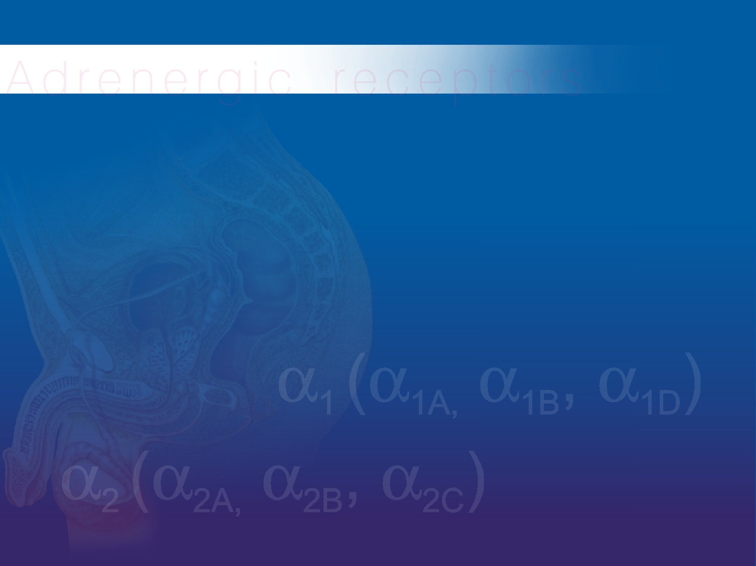
Thank You

